Slide 1

DATA STRUCTURES AND ALGORITHMS (113215)
Dr. Owais Hussain

Slide 2

Agenda
Complexity Analysis
Few Simple Examples
How to Calculate?
Bubble Sort
Selection Sort
Insertion Sort
DIY

Slide 3
Sample 2
Complexity Analysis
Complexity analysis consists of 3 cases:
Best case: the input is as close to the solution as possible. E.g., best case scenario to check an assignment is when no student submitted.
Average case: the input is as close to the real-life situation. E.g., average case for checking is when 70-80% students submitted.
Worst case: the input is as far to the solution as possible. E.g., worst-case for checking an assignment is when all students made a submission.

Slide 4
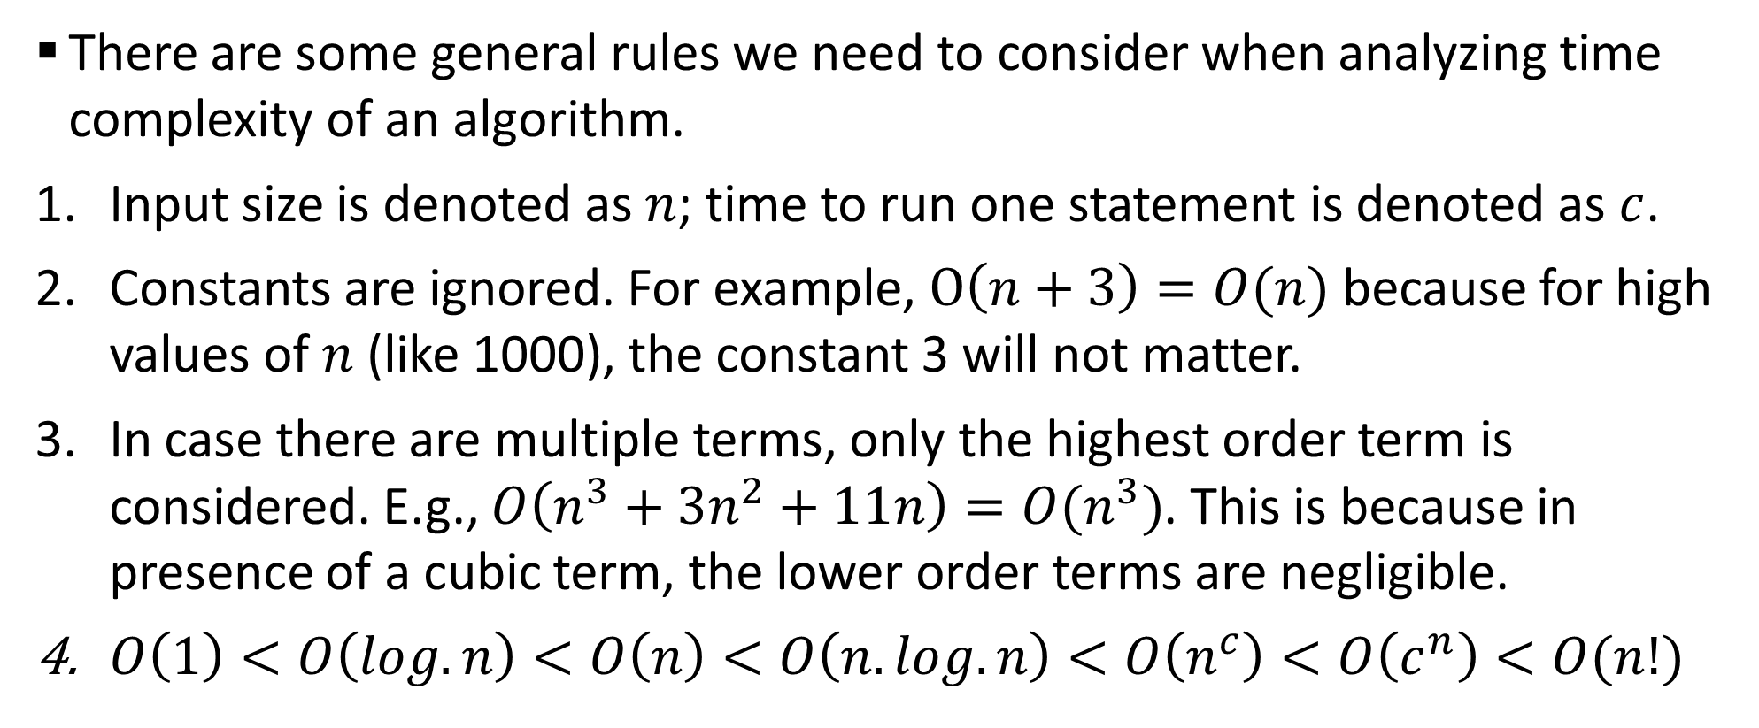
Sample 2
Complexity Analysis
There are some general rules we need to consider when analyzing time complexity of an algorithm.
Input size is denoted as $n$; time to run one statement is denoted as $c$.
Constants are ignored. For example, $O\left(n+3\right)=O(n)$ because for high values of $n$ (like 1000), the constant 3 will not matter.
In case there are multiple terms, only the highest order term is considered. E.g., $O\left(n^{3}+3n^{2}+11n\right)=O(n^{3})$. This is because in presence of a cubic term, the lower order terms are negligible.
$O\left(1\right)<O\left(log.n\right)<O\left(n\right)<O\left(n.log.n\right)<O\left(n^{c}\right)<O\left(c^{n}\right)<O(n!)$

Slide 5
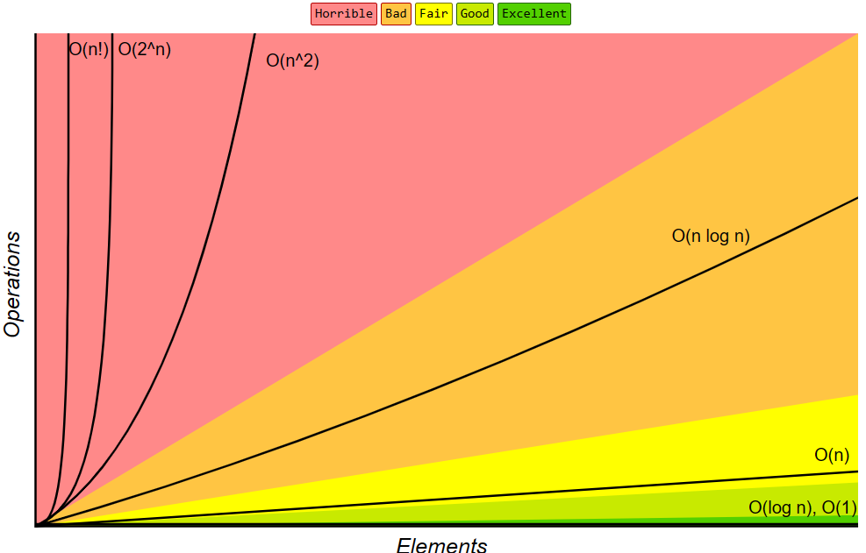
Sample 2
Complexity Analysis

Slide 6
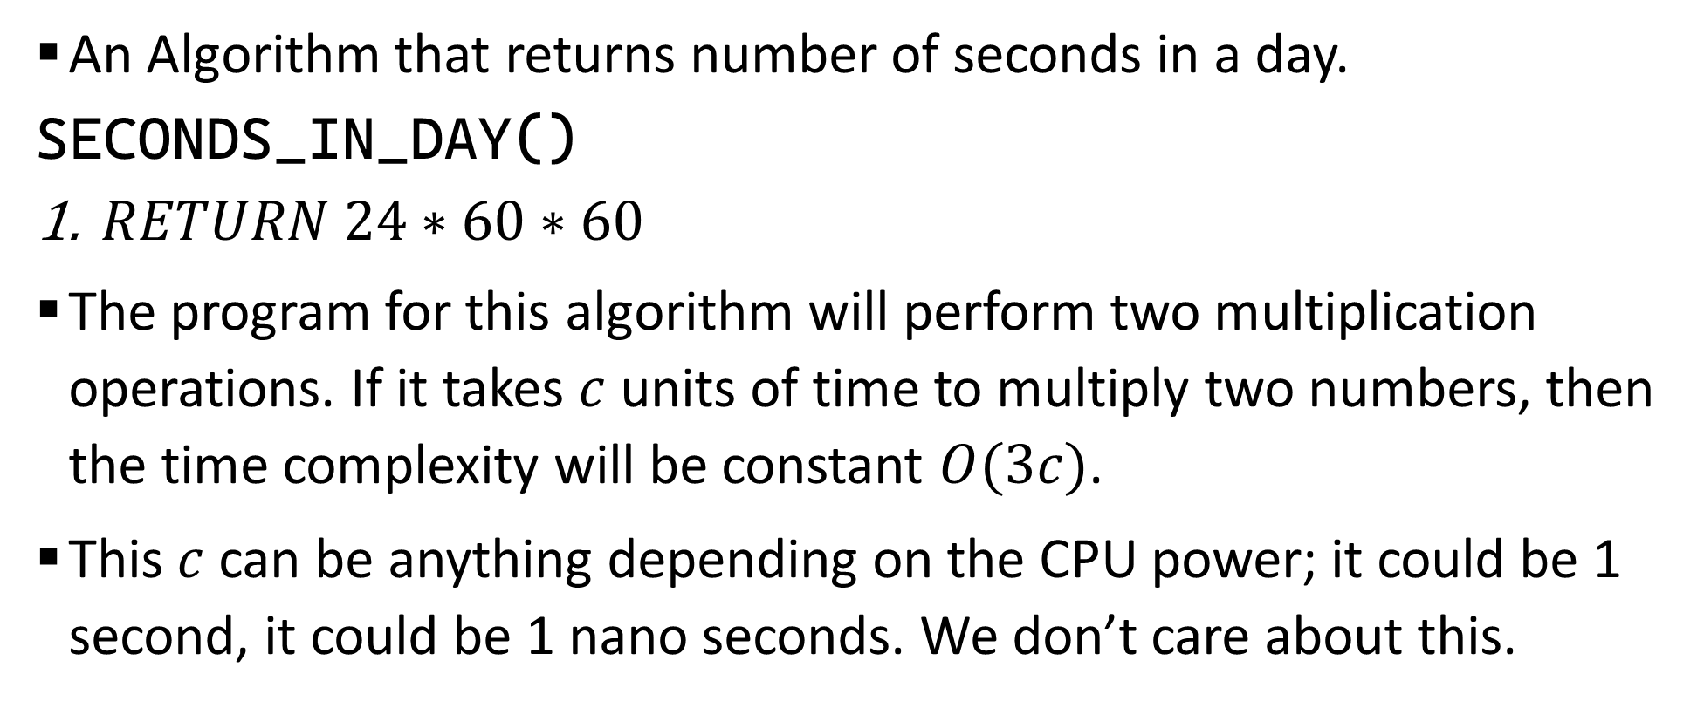
Sample 2
Few Simple Example
An Algorithm that returns number of seconds in a day.
SECONDS_IN_DAY()
$RETURN 24∗60∗60$
The program for this algorithm will perform two multiplication operations. If it takes $c$ units of time to multiply two numbers, then the time complexity will be constant $O(3c)$.
This $c$ can be anything depending on the CPU power; it could be 1 second, it could be 1 nano seconds. We don’t care about this.

Slide 7
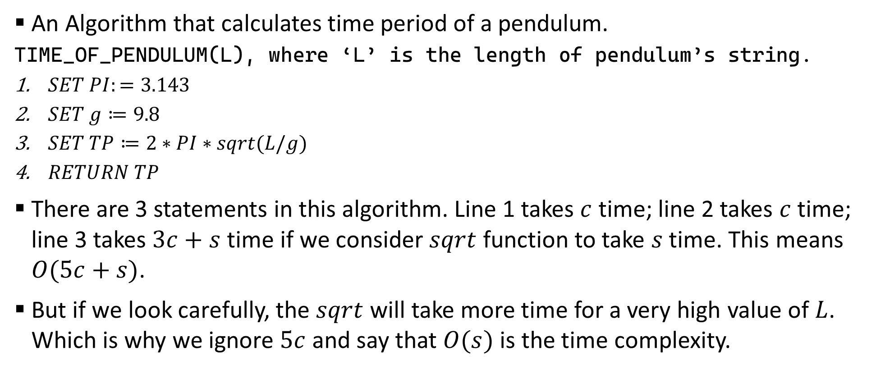
Sample 2
Few Simple Example
An Algorithm that calculates time period of a pendulum.
TIME_OF_PENDULUM(L), where ‘L’ is the length of pendulum’s string.
$SET PI:=3.143$
$SET g≔9.8$
$SET TP≔2∗PI∗sqrt(L/g)$
$RETURN TP$
There are 3 statements in this algorithm. Line 1 takes $c$ time; line 2 takes $c$ time; line 3 takes $3c+s$ time if we consider $sqrt$ function to take $s$ time. This means $O(5c+s)$.
But if we look carefully, the $sqrt$ will take more time for a very high value of $L$. Which is why we ignore $5c$ and say that $O(s)$ is the time complexity.

Slide 8
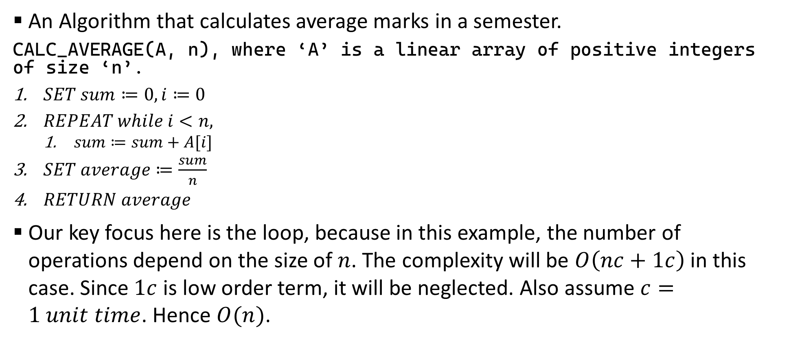
Sample 2
Few Simple Example
An Algorithm that calculates average marks in a semester.
CALC_AVERAGE(A, n), where ‘A’ is a linear array of positive integers of size ‘n’.
$SET sum≔0, i≔0$
$REPEAT while i<n,$
$sum≔sum+A[i]$
$SET average≔\frac{sum}{n}$
$RETURN average$
Our key focus here is the loop, because in this example, the number of operations depend on the size of $n$. The complexity will be $O\left(nc+1c\right)$ in this case. Since $1c$ is low order term, it will be neglected. Also assume $c=1 unit time$. Hence $O(n)$.

Slide 9
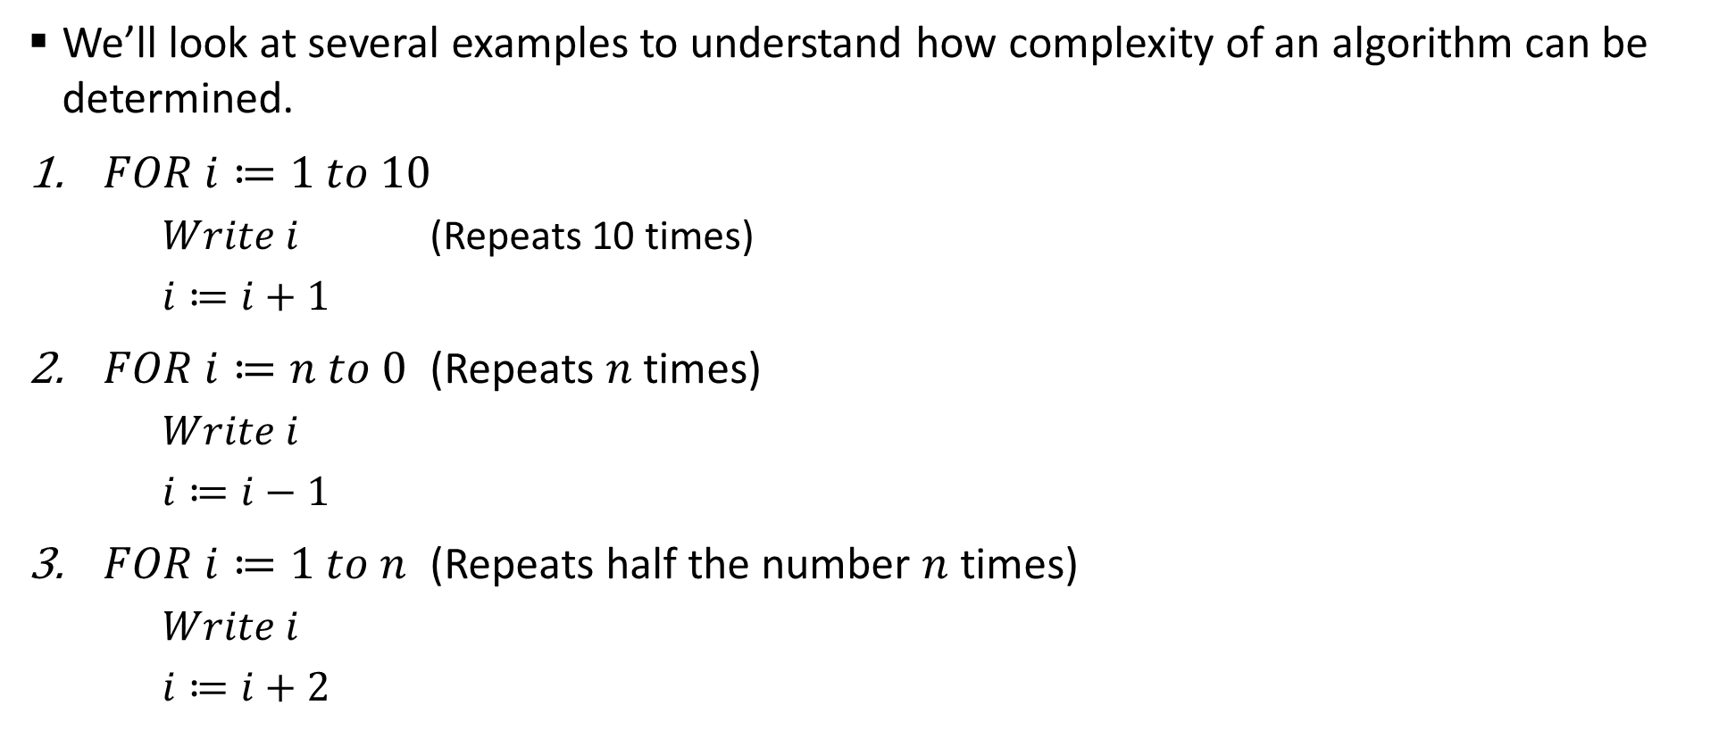
Sample 2
How to Calculate?
We’ll look at several examples to understand how complexity of an algorithm can be determined.
$FOR i≔1 to 10$
$Write i$ (Repeats 10 times)
$i≔i+1$
$FOR i≔n to 0$ (Repeats $n$ times)
$Write i$
$i≔i−1$
$FOR i≔1 to n$ (Repeats half the number $n$ times)
$Write i$
$i≔i+2$

Slide 10
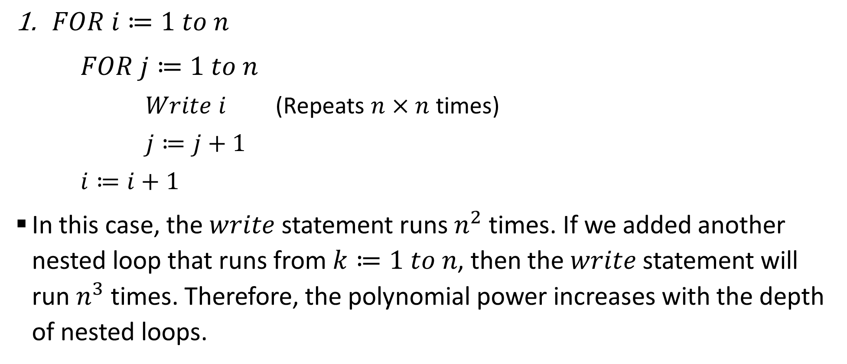
Sample 2
How to Calculate?
$FOR i≔1 to n$
$FOR j≔1 to n$
$Write i$ (Repeats $n×n$ times)
$j≔j+1$
$i≔i+1$
In this case, the $write$ statement runs $n^{2}$ times. If we added another nested loop that runs from $k≔1 to n$, then the $write$ statement will run $n^{3}$ times. Therefore, the polynomial power increases with the depth of nested loops.

Slide 11
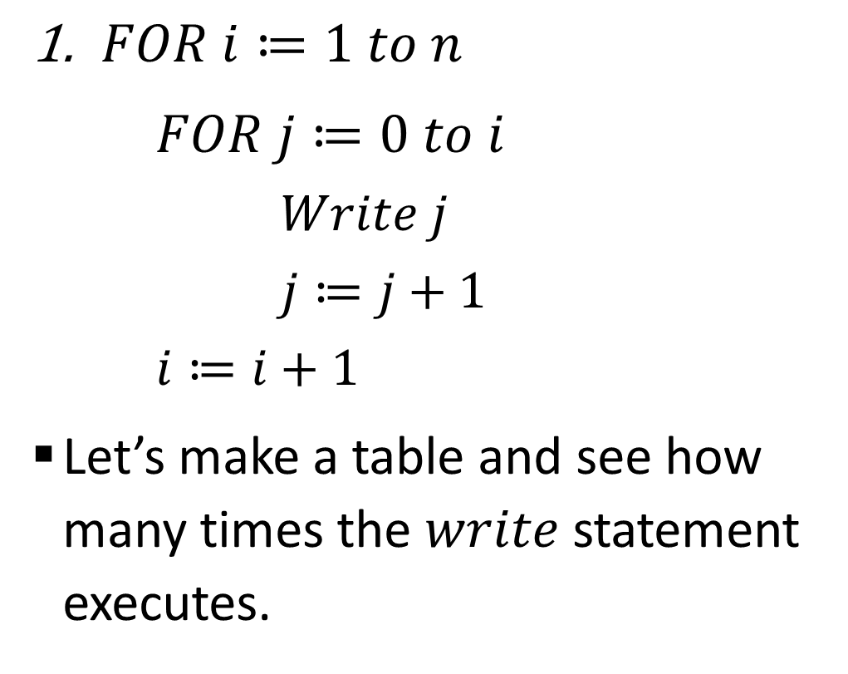
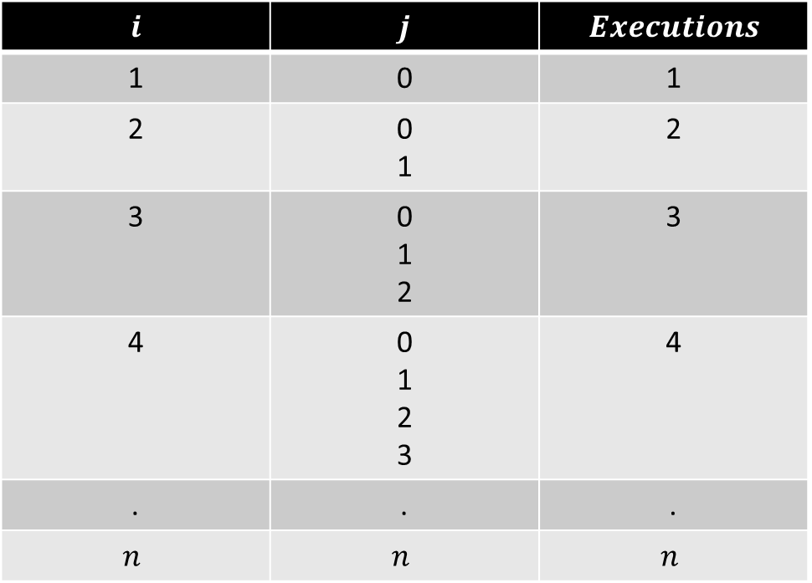
Sample 2
How to Calculate?
$FOR i≔1 to n$
$FOR j≔0 to i$
$Write j$
$j≔j+1$
$i≔i+1$
Let’s make a table and see how many times the $write$ statement executes.
$$i$$ | $$j$$ | $$Executions$$
1 | 0 | 1
2 | 0 1 | 2
3 | 0 1 2 | 3
4 | 0 1 2 3 | 4
. | . | .
$$n$$ | $$n$$ | $$n$$

Slide 12
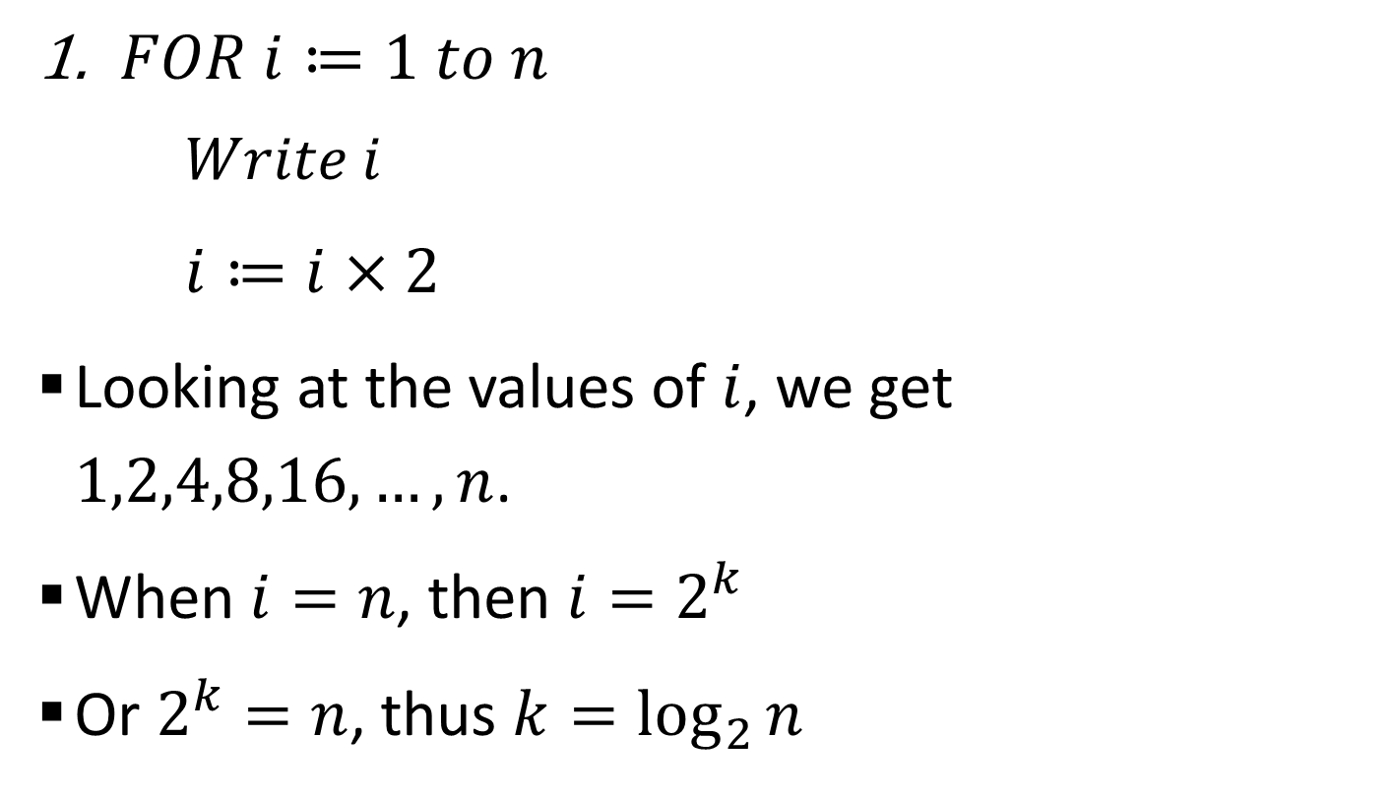
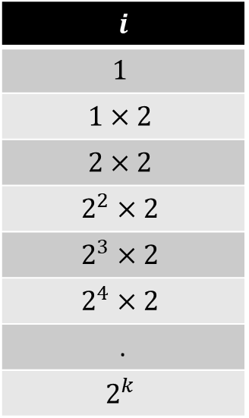
Sample 2
How to Calculate?
$FOR i≔1 to n$
$Write i$
$i≔i×2$
Looking at the values of $i$, we get $1,2,4,8,16,…,n$.
When $i=n$, then $i=2^{k}$
Or $2^{k}=n$, thus $k=\log_{2}{n}$
$$i$$
$$1$$
$$1×2$$
$$2×2$$
$$2^{2}×2$$
$$2^{3}×2$$
$$2^{4}×2$$
.
$$2^{k}$$

Slide 13
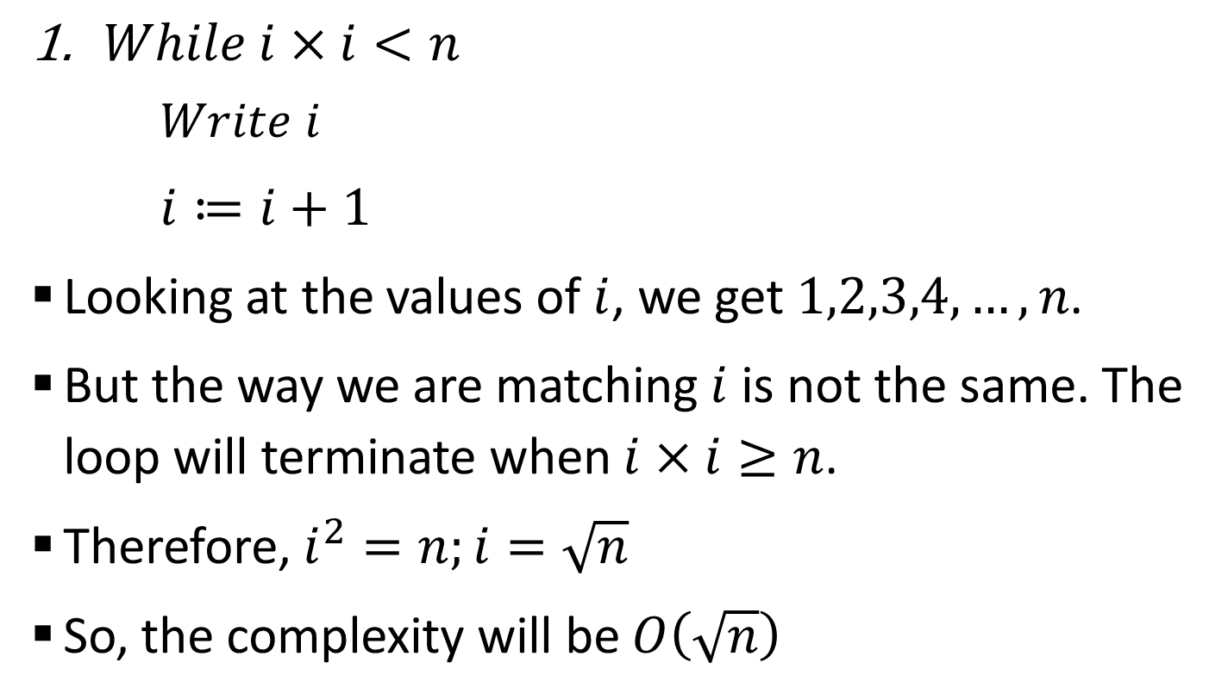
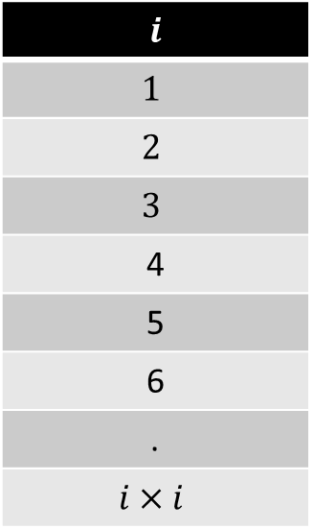
Sample 2
How to Calculate?
$While i×i<n$
$Write i$
$i≔i+1$
Looking at the values of $i$, we get $1,2,3,4,…,n$.
But the way we are matching $i$ is not the same. The loop will terminate when $i×i≥n$.
Therefore, $i^{2}=n;i=\sqrt{n}$
So, the complexity will be $O\left(\sqrt{n}\right)$
$$i$$
$$1$$
$$2$$
$$3$$
4
5
6
.
$$i×i$$
Notes:
At this point, recommend the video on time complexity by Abdul Bari: https://www.youtube.com/watch?v=9SgLBjXqwd4&t=1s

Slide 14
Sample 2
Exercise
Write Pseudocode and compute worst-case time complexity of an algorithm which takes your year of birth and current year as input and returns the total number of leap years which fell in between these two years.

Slide 15
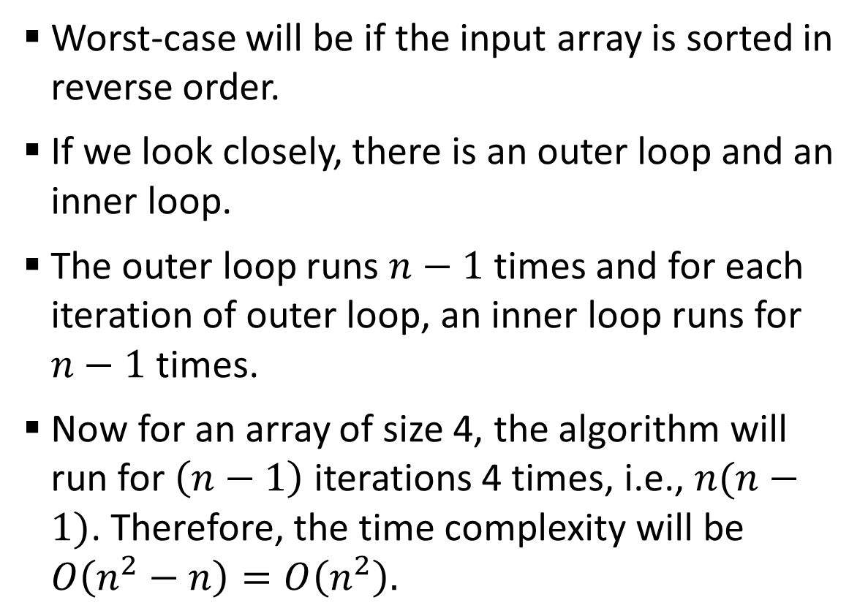
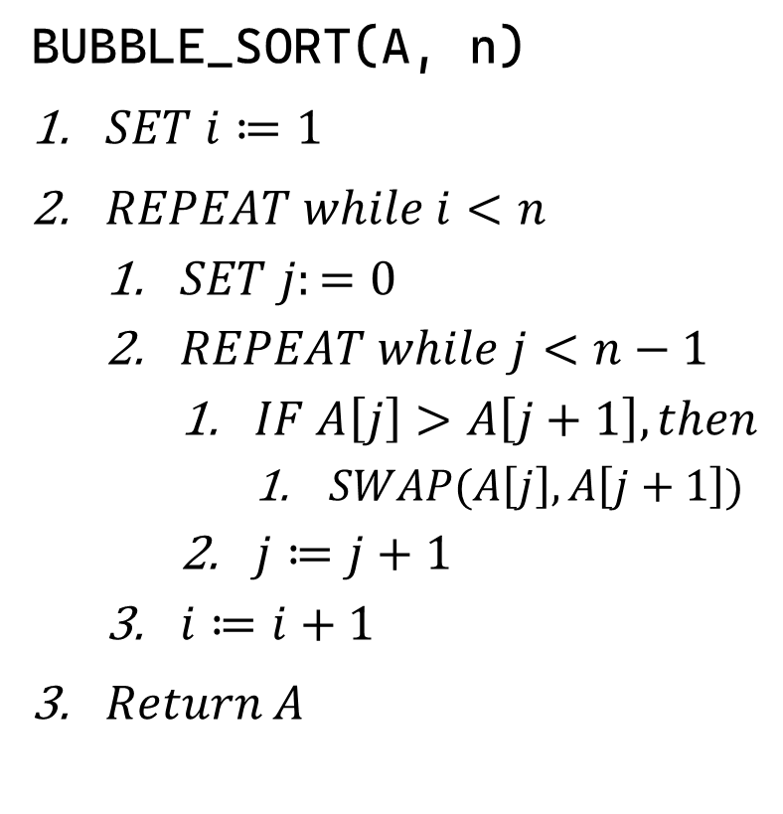
Sample 2
Bubble Sort
Worst-case will be if the input array is sorted in reverse order.
If we look closely, there is an outer loop and an inner loop.
The outer loop runs $n−1$ times and for each iteration of outer loop, an inner loop runs for $n−1$ times.
Now for an array of size 4, the algorithm will run for $\left(n−1\right)$ iterations 4 times, i.e., $n(n−1)$. Therefore, the time complexity will be $O\left(n^{2}−n\right)=O\left(n^{2}\right).$
BUBBLE_SORT(A, n)
$SET i≔1$
$REPEAT while i<n$
$SET j:=0$
$REPEAT while j<n−1$
$IF A\left[j\right]>A\left[j+1\right], then$
$SWAP(A\left[j\right], A\left[j+1\right])$
$j≔j+1$
$i≔i+1$
$Return A$
Notes:
The swap operation takes 3 statements, thus a constant. Same goes with other statements.

Slide 16
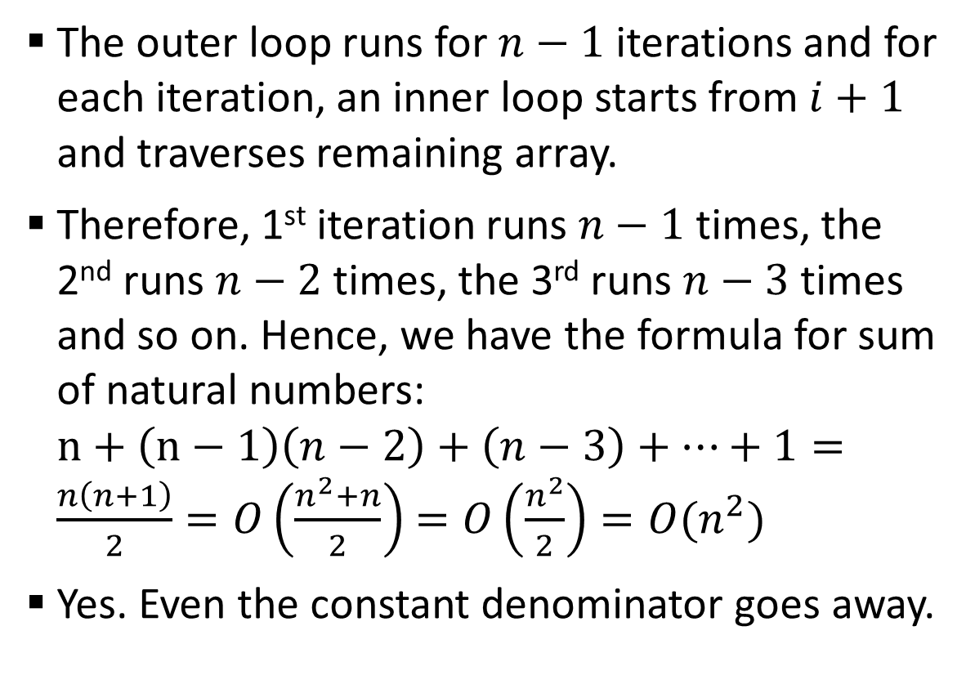
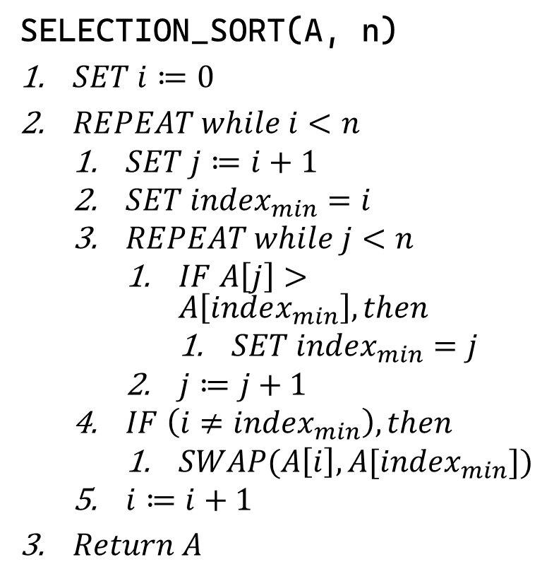
Sample 2
Selection Sort
The outer loop runs for $n−1$ iterations and for each iteration, an inner loop starts from $i+1$ and traverses remaining array.
Therefore, 1st iteration runs $n−1$ times, the 2nd runs $n−2$ times, the 3rd runs $n−3$ times and so on. Hence, we have the formula for sum of natural numbers: $n+\left(n−1\right)\left(n−2\right)+\left(n−3\right)+…+1=\frac{n\left(n+1\right)}{2}=O\left(\frac{n^{2}+n}{2}\right)$ $=O\left(\frac{n^{2}}{2}\right)=O(n^{2})$
Yes. Even the constant denominator goes away.
SELECTION_SORT(A, n)
$SET i≔0$
$REPEAT while i<n$
$SET j≔i+1$
$SET index_{min}=i$
$REPEAT while j<n$
$IF A\left[j\right]>A\left[index_{min}\right], then$
$SET index_{min}=j$
$j≔j+1$
$IF \left(i≠index_{min}\right), then$
$SWAP(A\left[i\right], A[index_{min}])$
$i≔i+1$
$Return A$

Slide 17
Sample 2
Exercise
Form groups of 5 students each.
Given an array of SIDs in your group written in random order.
Assuming each statement costs 2ms to run, what will be the total runtime of your execution in milliseconds?
Tip! Make a state table to mimic how the array will be sorted. Like:
No. | Current state | Next state
1 | 11, 51, 40, 19, 9 | 11, 51, 40, 19, 9
2 | 11, 51, 40, 19, 9 | 11, 40, 51, 19, 9
3 | 11, 40, 51, 19, 9 | 11, 40, 19, 51, 9

Slide 18
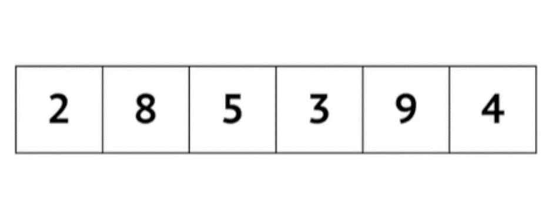
Sample 2
The array is:
2 8 5 3 9 4 1
The array is:
2 8 5 3 9 4 1
Swapping 8 with 5
The array is:
2 5 8 3 9 4 1
Swapping 8 with 3
Swapping 5 with 3
The array is:
2 3 5 8 9 4 1
The array is:
2 3 5 8 9 4 1
Swapping 9 with 4
Swapping 8 with 4
Swapping 5 with 4
The array is:
2 3 4 5 8 9 1
Swapping 9 with 1
Swapping 8 with 1
Swapping 5 with 1
Swapping 4 with 1
Swapping 3 with 1
Swapping 2 with 1
The array is:
1 2 3 4 5 8 9
Insertion Sort
Let’s now try to guess the time complexity only by looking at the simulation.
Watch carefully the simulation as well as the runtime log of the program which sorts this array using Insertion sort.

Slide 19
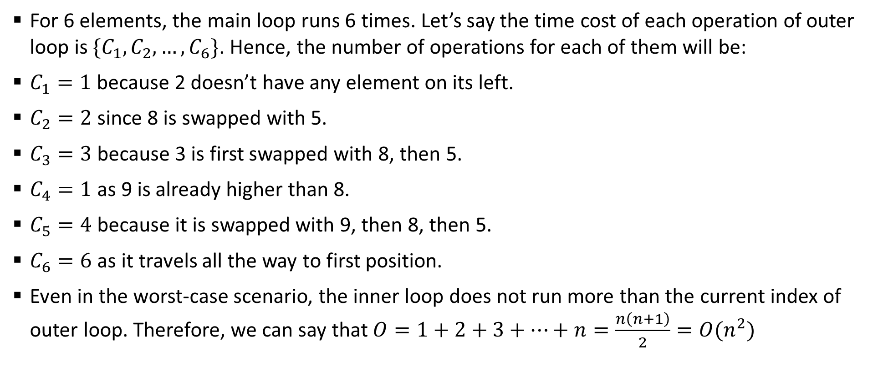
Sample 2
Insertion Sort
For 6 elements, the main loop runs 6 times. Let’s say the time cost of each operation of outer loop is $\{C_{1},C_{2},…,C_{6}\}$. Hence, the number of operations for each of them will be:
$C_{1}=1$ because 2 doesn’t have any element on its left.
$C_{2}=2$ since 8 is swapped with 5.
$C_{3}=3$ because 3 is first swapped with 8, then 5.
$C_{4}=1$ as 9 is already higher than 8.
$C_{5}=4$ because it is swapped with 9, then 8, then 5.
$C_{6}=6$ as it travels all the way to first position.
Even in the worst-case scenario, the inner loop does not run more than the current index of outer loop. Therefore, we can say that $O=1+2+3+…+n=\frac{n\left(n+1\right)}{2}=O(n^{2})$

Slide 20
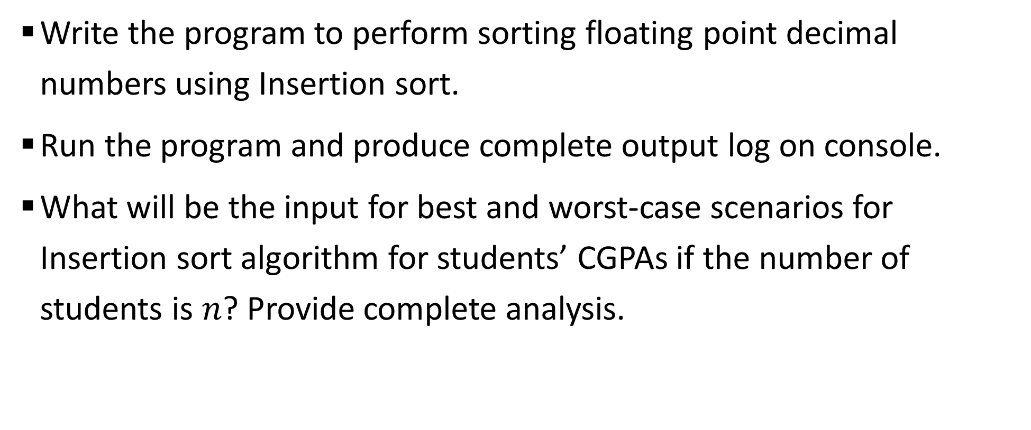
Sample 2
Assignment 2
Write the program to perform sorting floating point decimal numbers using Insertion sort.
Run the program and produce complete output log on console.
What will be the input for best and worst-case scenarios for Insertion sort algorithm for students’ CGPAs if the number of students is $n$? Provide complete analysis.

Slide 21

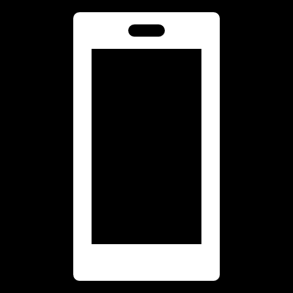

THANK YOU
Owais Hussain
+92 345-3174270
owais.hussain@kiet.edu.pk
https://www.researchgate.net/profile/Owais-Hussain-3

